Slide 1
Midterm Review
Hongning Wang
CS@UVa

Slide 2
Core concepts
Search Engine Architecture
Key components in a modern search engine
Crawling & Text processing
Different strategies for crawling
Challenges in crawling
Text processing pipeline
Zipf’s law
Inverted index
Index compression
Phase queries

Slide 3
Core concepts
Vector space model
Basic term/document weighting schemata
Latent semantic analysis
Word space to concept space
Probabilistic ranking principle
Risk minimization
Document generation model
Language model
N-gram language models
Smoothing techniques

Slide 4
Core concepts
Classical IR evaluations
Basic components in IR evaluations
Evaluation metrics
Annotation strategy and annotation consistency

Slide 5
Abstraction of search engine architecture
Indexed corpus
Crawler
Ranking procedure
Research attention
Feedback
Evaluation
Doc Analyzer
(Query)
Query Rep
User
Doc Representation
Ranker
Indexer
results
Index

Slide 6
IR v.s. DBs
Information Retrieval:
Unstructured data
Semantics of objects are subjective
Simple keyword queries
Relevance-drive retrieval
Effectiveness is primary issue, though efficiency is also important
Database Systems:
Structured data
Semantics of each object are well defined
Structured query languages (e.g., SQL)
Exact retrieval
Emphasis on efficiency

Slide 7
Crawler: visiting strategy
Breadth first
Uniformly explore from the entry page
Memorize all nodes on the previous level
As shown in pseudo code
Depth first
Explore the web by branch
Biased crawling given the web is not a tree structure
Focused crawling
Prioritize the new links by predefined strategies
Challenges
Avoid duplicate visits
Re-visit policy

Slide 8
Automatic text indexing
Tokenization
Regular expression based
Learning-based
Normalization
Stemming
Stopword removal

Slide 9
Statistical property of language
discrete version of power law
Zipf’s law
Frequency of any word is inversely proportional to its rank in the frequency table
Formally
$f\left(k;s,N\right)=\frac{1/k^{s}}{\sum_{n=1}^{N}{1/n^{s}}}$
where $k$ is rank of the word; $N$ is the vocabulary size; $s$ is language-specific parameter

Slide 10
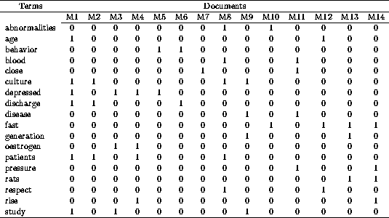
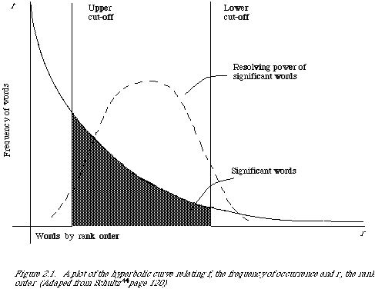
Automatic text indexing
Remove non-informative words
Remove 1s
Remove 0s
Remove rare words

Slide 11
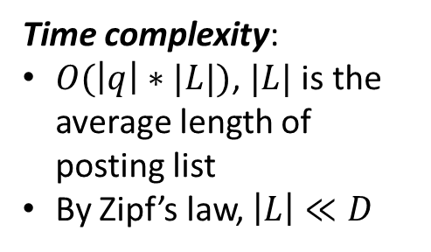
Inverted index
Build a look-up table for each word in vocabulary
From word to find documents!
Dictionary
Postings
information
retrieval
retrieved
is
helpful
for
you
everyone
Doc1
Doc2
Time complexity:
$O(\left|q\right|∗|L|)$, $|L|$ is the average length of posting list
By Zipf’s law, $\left|L\right|≪D$
Doc1
Query:
information
retrieval
Doc2
Doc1
Doc2
Doc1
Doc2
Doc1
Doc2
Doc2
Doc1

Slide 12
Structures for inverted index
Dictionary: modest size
Needs fast random access
Stay in memory
Hash table, B-tree, trie, …
Postings: huge
Sequential access is expected
Stay on disk
Contain docID, term freq, term position, …
Compression is needed
“Key data structure underlying modern IR”
- Christopher D. Manning

Slide 13
Sorting-based inverted index construction
<Tuple>: <termID, docID, count>
Sort by docId
Sort by termId
All info about term 1
doc1
<1,1,3>
<2,1,2>
<3,1,1>
...
<1,2,2>
<3,2,3>
<4,2,5>
…
<1,300,3>
<3,300,1>
...
<1,1,3>
<1,2,2>
<2,1,2>
<2,4,3>
...
<1,5,3>
<1,6,2>
…
<1,299,3>
<1,300,1>
...
<1,1,3>
<1,2,2>
<1,5,2>
<1,6,3>
...
<1,300,3>
<2,1,2>
…
<5000,299,1>
<5000,300,1>
...
Term Lexicon:
1 the
2 cold
3 days
4 a
...
doc2
...
DocID
Lexicon:
1 doc1
2 doc2
3 doc3
...
doc300
Parse & Count
“Local” sort
Merge sort

Slide 14
A close look at inverted index
Approximate search:
e.g., misspelled queries, wildcard queries
Proximity search:
e.g., phrase queries
Dictionary
Postings
information
retrieval
retrieved
is
helpful
for
you
everyone
Doc1
Doc2
Doc1
Dynamic index update
Doc2
Doc1
Doc2
Doc1
Doc2
Doc1
Doc2
Index compression
Doc2
Doc1

Slide 15
Index compression
Observation of posting files
Instead of storing docID in posting, we store gap between docIDs, since they are ordered
Zipf’s law again:
The more frequent a word is, the smaller the gaps are
The less frequent a word is, the shorter the posting list is
Heavily biased distribution gives us great opportunity of compression!
Information theory: entropy measures compression difficulty.

Slide 16
Phrase query
Generalized postings matching
Equality condition check with requirement of position pattern between two query terms
e.g., T2.pos-T1.pos = 1 (T1 must be immediately before T2 in any matched document)
Proximity query: |T2.pos-T1.pos| ≤ k
scan the postings
Term1
2
4
8
16
32
64
128
Term2
1
2
3
5
8
13
21
34

Slide 17
Considerations in result display
Relevance
Order the results by relevance
Diversity
Maximize the topical coverage of the displayed results
Navigation
Help users easily explore the related search space
Query suggestion
Search by example

Slide 18
Deficiency of Boolean model
The query is unlikely precise
“Over-constrained” query (terms are too specific): no relevant documents can be found
“Under-constrained” query (terms are too general): over delivery
It is hard to find the right position between these two extremes (hard for users to specify constraints)
Even if it is accurate
Not all users would like to use such queries
All relevant documents are not equally important
No one would go through all the matched results
Relevance is a matter of degree!

Slide 19
Vector space model
Represent both doc and query by concept vectors
Each concept defines one dimension
K concepts define a high-dimensional space
Element of vector corresponds to concept weight
E.g., d=(x₁,…,x_{k}), x_{i} is “importance” of concept i
Measure relevance
Distance between the query vector and document vector in this concept space

Slide 20
What is a good “basic concept”?
Orthogonal
Linearly independent basis vectors
“Non-overlapping” in meaning
No ambiguity
Weights can be assigned automatically and accurately
Existing solutions
Terms or N-grams, i.e., bag-of-words
Topics, i.e., topic model

Slide 21
TF normalization
Sublinear TF scaling
$tf\left(t,d\right)=\left\{\begin{aligned}1+\log{f\left(t,d\right)}, if f\left(t,d\right)>0 \\ 0, otherwise\end{aligned}\right.$
Norm. TF
Raw TF

Slide 22
TF normalization
Maximum TF scaling
$tf\left(t,d\right)=α+(1−α)\frac{f(t,d)}{\max_{t}{f(t,d)}}$
Normalize by the most frequent word in this doc
Norm. TF
1
$$α$$
Raw TF

Slide 23
IDF weighting
Solution
Assign higher weights to the rare terms
Formula
$IDF\left(t\right)=1+log⁡(\frac{N}{df(t)})$
A corpus-specific property
Independent of a single document
Non-linear scaling
Total number of docs in collection
Number of docs containing term $t$

Slide 24
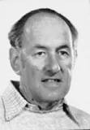
TF-IDF weighting
Combining TF and IDF
Common in doc → high tf → high weight
Rare in collection→ high idf→ high weight
$w\left(t,d\right)=TF\left(t,d\right)×IDF(t)$
Most well-known document representation schema in IR! (G Salton et al. 1983)
“Salton was perhaps the leading computer scientist working in the field of information retrieval during his time.” - wikipedia
Gerard Salton Award
– highest achievement award in IR

Slide 25
From distance to angle
Angle: how vectors are overlapped
Cosine similarity – projection of one vector onto another
Finance
TF-IDF space
D₁
The choice of angle
The choice of Euclidean distance
D₂
Query
Sports

Slide 26
Advantages of VS Model
Empirically effective! (Top TREC performance)
Intuitive
Easy to implement
Well-studied/Mostly evaluated
The Smart system
Developed at Cornell: 1960-1999
Still widely used
Warning: Many variants of TF-IDF!

Slide 27
Disadvantages of VS Model
Assume term independence
Assume query and document to be the same
Lack of “predictive adequacy”
Arbitrary term weighting
Arbitrary similarity measure
Lots of parameter tuning!

Slide 28
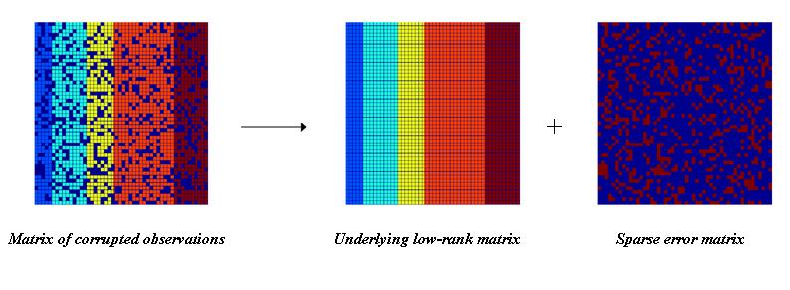
Latent semantic analysis
Solution
Low rank matrix approximation
Imagine this is *true* concept-document matrix
Imagine this is our observed term-document matrix
Random noise over the word selection in each document

Slide 29
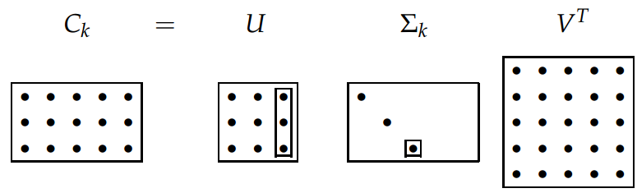
Latent Semantic Analysis (LSA)
Solve LSA by SVD
Procedure of LSA
Perform SVD on document-term adjacency matrix
Construct $C_{M×N}^{k}$ by only keeping the largest $k$ singular values in $Σ$ non-zero
Map to a lower dimensional space
$$\hat{Z}=\underset{Z|rank\left(Z\right)=k}{argmin}{{\left\|C−Z\right\|}_{F}}$$
$=\underset{Z|rank\left(Z\right)=k}{argmin}{\sqrt{\sum_{i=1}^{M}{\sum_{j=1}^{N}{{\left(C_{ij}−Z_{ij}\right)}^{2}}}}}$
$=C_{M×N}^{k}$

Slide 30
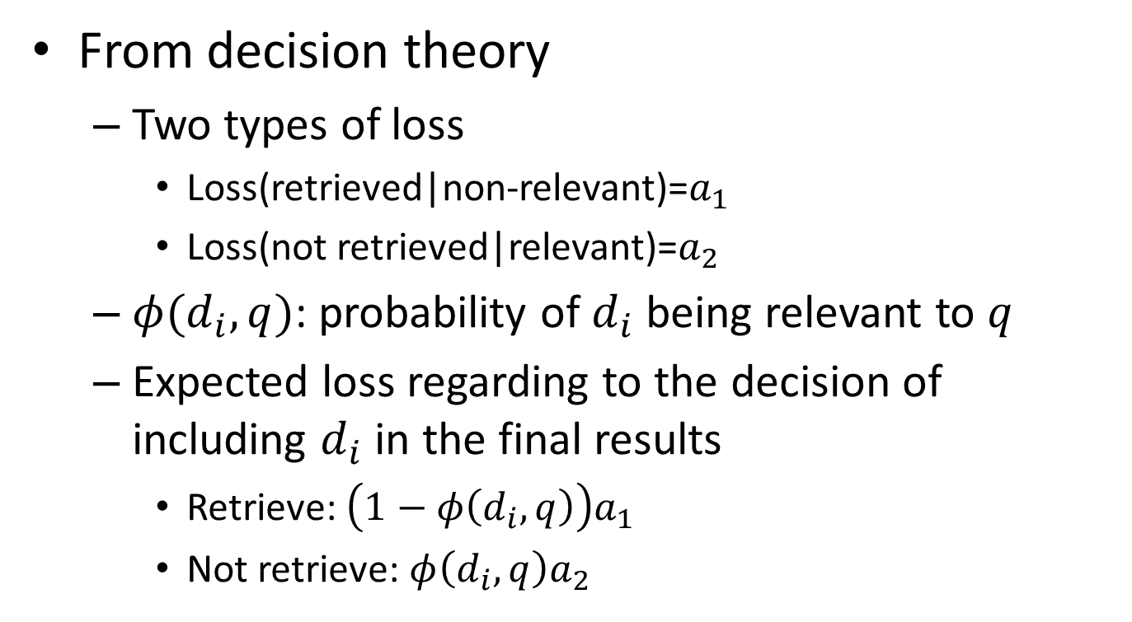
Probabilistic ranking principle
From decision theory
Two types of loss
Loss(retrieved|non-relevant)=$a_{1}$
Loss(not retrieved|relevant)=$a_{2}$
$φ(d_{i},q)$: probability of $d_{i}$ being relevant to $q$
Expected loss regarding to the decision of including $d_{i}$ in the final results
Retrieve: $\left(1−φ\left(d_{i},q\right)\right)a_{1}$
Not retrieve: $φ\left(d_{i},q\right)a_{2}$
Your decision criterion?

Slide 31
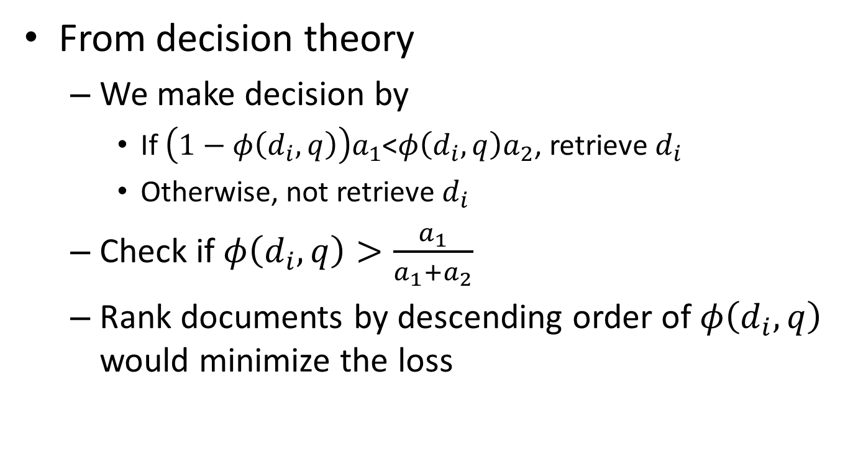
Probabilistic ranking principle
From decision theory
We make decision by
If $\left(1−φ\left(d_{i},q\right)\right)a_{1}$<$φ\left(d_{i},q\right)a_{2}$, retrieve $d_{i}$
Otherwise, not retrieve $d_{i}$
Check if $φ\left(d_{i},q\right)>\frac{a_{1}}{a_{1}+a_{2}}$
Rank documents by descending order of $φ\left(d_{i},q\right)$ would minimize the loss

Slide 32
Conditional models for P(R=1|Q,D)
Basic idea: relevance depends on how well a query matches a document
P(R=1|Q,D)=g(Rep(Q,D)|θ)
Rep(Q,D): feature representation of query-doc pair
E.g., #matched terms, highest IDF of a matched term, docLen
Using training data (with known relevance judgments) to estimate parameter θ
Apply the model to rank new documents
Special case: logistic regression
a functional form

Slide 33
Generative models for P(R=1|Q,D)
Basic idea
Compute Odd(R=1|Q,D) using Bayes’ rule
Assumption
Relevance is a binary variable
Variants
Document “generation”
P(Q,D|R)=P(D|Q,R)P(Q|R)
Query “generation”
P(Q,D|R)=P(Q|D,R)P(D|R)
Ignored for ranking

Slide 34
Document generation model
Terms occur in doc
Terms do not occur in doc
Important tricks
Assumption: terms not occurring in the query are equally likely to occur in relevant and nonrelevant documents, i.e., p_{t}=u_{t}
document | relevant(R=1) | nonrelevant(R=0)
term present A_{i}=1 | p_{i} | u_{i}
term absent A_{i}=0 | 1-p_{i} | 1-u_{i}

Slide 35
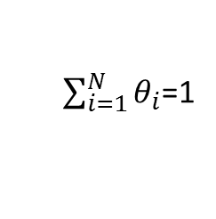
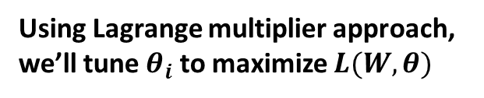
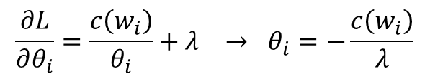

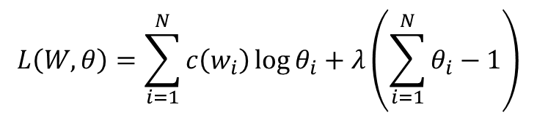
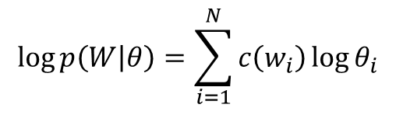

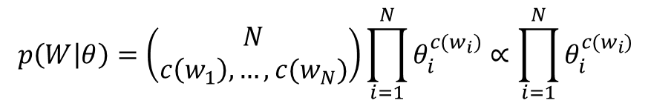

Maximum likelihood estimation
Data: a document d with counts c(w₁), …, c(w_{N})
Model: multinomial distribution $p(W|θ)$ with parameters $θ_{i}=p(w_{i})$
Maximum likelihood estimator: $\hat{θ}=argmax_{θ}p(W|θ)$
$$p\left(W | θ\right)=\left(\begin{matrix}N \\ c\left(w_{1}\right),…,c(w_{N})\end{matrix}\right)\prod_{i=1}^{N}{θ_{i}^{c(w_{i})}}∝\prod_{i=1}^{N}{θ_{i}^{c(w_{i})}}$$
$$\log{p\left(W | θ\right)}=\sum_{i=1}^{N}{c\left(w_{i}\right)\log{θ_{i}}}$$
$$L\left(W,θ\right)=\sum_{i=1}^{N}{c\left(w_{i}\right)\log{θ_{i}}}+λ\left(\sum_{i=1}^{N}{θ_{i}}−1\right)$$
Using Lagrange multiplier approach, we’ll tune $θ_{i}$ to maximize $L(W,θ)$
$$\frac{∂L}{∂θ_{i}}=\frac{c\left(w_{i}\right)}{θ_{i}}+λ → θ_{i}=−\frac{c\left(w_{i}\right)}{λ}$$
Set partial derivatives to zero
$$λ=−\sum_{i=1}^{N}{c\left(w_{i}\right)}$$
Since
$\sum_{i=1}^{N}{θ_{i}}$=1
we have
Requirement from probability
$$θ_{i}=\frac{c\left(w_{i}\right)}{\sum_{i=1}^{N}{c\left(w_{i}\right)}}$$
ML estimate

Slide 36

The BM25 formula
TF-IDF component for document
TF component for query
A closer look
$b$ is usually set to [0.75, 1.2]
$k_{1}$is usually set to [1.2, 2.0]
$k_{2}$ is usually set to (0, 1000]
Vector space model with TF-IDF schema!

Slide 37
Source-Channel framework ^{[Shannon 48]}
Source
Transmitter
(encoder)
Noisy
Channel
Receiver
(decoder)
Destination
X
Y
X’
P(X)
P(X|Y)=?
P(Y|X)
(Bayes Rule)
When X is text, p(X) is a language model
Many Examples:
Speech recognition: X=Word sequence Y=Speech signal
Machine translation: X=English sentence Y=Chinese sentence
OCR Error Correction: X=Correct word Y= Erroneous word
Information Retrieval: X=Document Y=Query
Summarization: X=Summary Y=Document

Slide 38
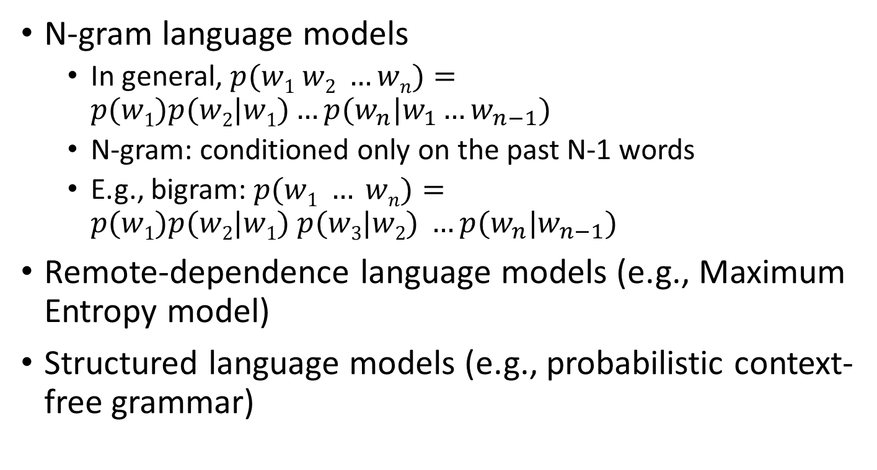
More sophisticated LMs
N-gram language models
In general, $p(w1 w2 …wn)=p(w1)p(w2|w1)…p(w_{n}|w_{1}…w_{n−1})$
N-gram: conditioned only on the past N-1 words
E.g., bigram: $p(w1 … wn)=p(w1)p(w2|w1) p(w3|w2) …p(w_{n}|w_{n−1})$
Remote-dependence language models (e.g., Maximum Entropy model)
Structured language models (e.g., probabilistic context-free grammar)

Slide 39
Justification from PRP
Query generation
Query likelihood p(q| θ_{d})
Document prior
Assuming uniform document prior, we have

Slide 40
Problem with MLE
What probability should we give a word that has not been observed in the document?
log0?
If we want to assign non-zero probabilities to such words, we’ll have to discount the probabilities of observed words
This is so-called “smoothing”

Slide 41
Illustration of language model smoothing
P(w|d)
Max. Likelihood Estimate
Smoothed LM
w
Discount from the seen words
Assigning nonzero probabilities to the unseen words

Slide 42
Refine the idea of smoothing
Should all unseen words get equal probabilities?
We can use a reference model to discriminate unseen words
Discounted ML estimate
Reference language model

Slide 43
Smoothing methods
Method 1: Additive smoothing
Add a constant δ to the counts of each word
Problems?
Hint: all words are equally important?
Counts of w in d
“Add one”, Laplace smoothing
Vocabulary size
Length of d (total counts)

Slide 44
Smoothing methods
Method 2: Absolute discounting
Subtract a constant δ from the counts of each word
Problems?
Hint: varied document length?
# uniq words

Slide 45
Smoothing methods
Method 3: Linear interpolation, Jelinek-Mercer
“Shrink” uniformly toward p(w|REF)
Problems?
Hint: what is missing?
parameter
MLE

Slide 46
Smoothing methods
Method 4: Dirichlet Prior/Bayesian
Assume pseudo counts μp(w|REF)
Problems?
parameter

Slide 47
Two-stage smoothing ^{[Zhai & Lafferty 02]}
Stage-1
-Explain unseen words
-Dirichlet prior (Bayesian)
Stage-2
-Explain noise in query
-2-component mixture
μ
λ
Collection LM
c(w,d)
+μp(w|C)
P(w|d) =
(1-λ)
+ λp(w|U)
|d|
+μ
User background model

Slide 48




Understanding smoothing
Topical words
Query = “the algorithms for data mining”
p_{ML}(w|d1): 0.04 0.001 0.02 0.002 0.003
p_{ML}(w|d2): 0.02 0.001 0.01 0.003 0.004
$$4.8×{10}^{−12}$$
$$2.4×{10}^{−12}$$
p( “algorithms”|d1) = p(“algorithms”|d2)
p( “data”|d1) < p(“data”|d2)
p( “mining”|d1) < p(“mining”|d2)
Intuitively, d2 should have a higher score,
but p(q|d1)>p(q|d2)…
So we should make p(“the”) and p(“for”) less different for all docs,
and smoothing helps to achieve this goal…
$$2.35×{10}^{−13}$$
$$4.53×{10}^{−13}$$
Query = “the algorithms for data mining”
P(w|REF) 0.2 0.00001 0.2 0.00001 0.00001
Smoothed p(w|d1): 0.184 0.000109 0.182 0.000209 0.000309
Smoothed p(w|d2): 0.182 0.000109 0.181 0.000309 0.000409

Slide 49
Smoothing & TF-IDF weighting
Smoothed ML estimate
Retrieval formula using the general smoothing scheme
Reference language model
$$c\left(w,q\right)>0$$
Key rewriting step (where did we see it before?)
Similar rewritings are very common when using probabilistic models for IR…

Slide 50
Retrieval evaluation
Aforementioned evaluation criteria are all good, but not essential
Goal of any IR system
Satisfying users’ information need
Core quality measure criterion
“how well a system meets the information needs of its users.” – wiki
Unfortunately vague and hard to execute

Slide 51
Classical IR evaluation
Three key elements for IR evaluation
A document collection
A test suite of information needs, expressible as queries
A set of relevance judgments, e.g., binary assessment of either relevant or nonrelevant for each query-document pair

Slide 52

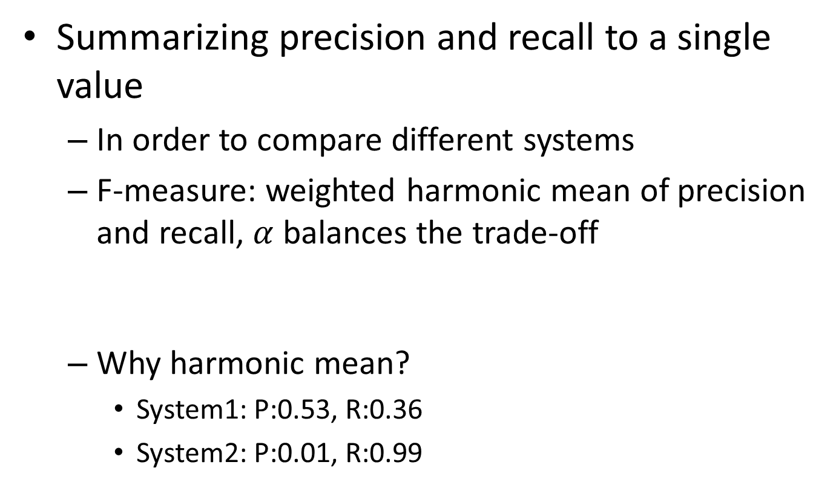

Evaluation of unranked retrieval sets
Summarizing precision and recall to a single value
In order to compare different systems
F-measure: weighted harmonic mean of precision and recall, $α$ balances the trade-off
Why harmonic mean?
System1: P:0.53, R:0.36
System2: P:0.01, R:0.99
$$F=\frac{1}{α\frac{1}{P}+\left(1−α\right)\frac{1}{R}}$$
$$\left(F_{1}=\frac{2}{\frac{1}{P}+\frac{1}{R}} \right)$$
H | A
0.429 | 0.445
0.019 | 0.500
Equal weight between precision and recall

Slide 53
Evaluation of ranked retrieval results
Summarize the ranking performance with a single number
Binary relevance
Eleven-point interpolated average precision
Precision@K (P@K)
Mean Average Precision (MAP)
Mean Reciprocal Rank (MRR)
Multiple grades of relevance
Normalized Discounted Cumulative Gain (NDCG)

Slide 54
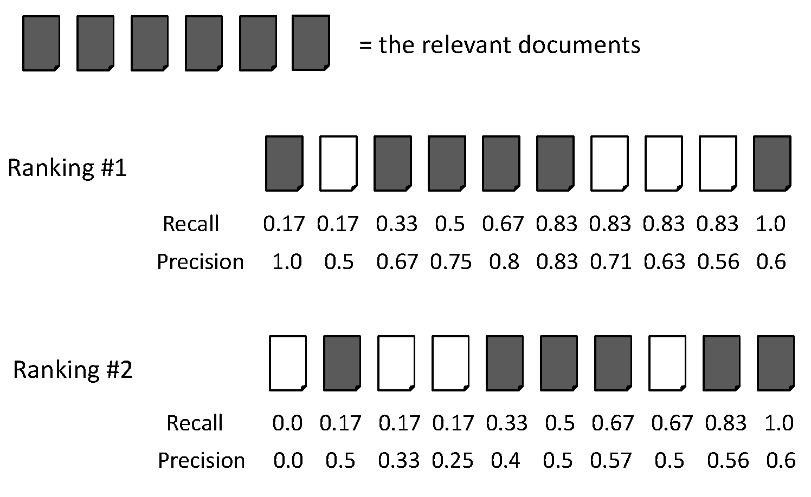
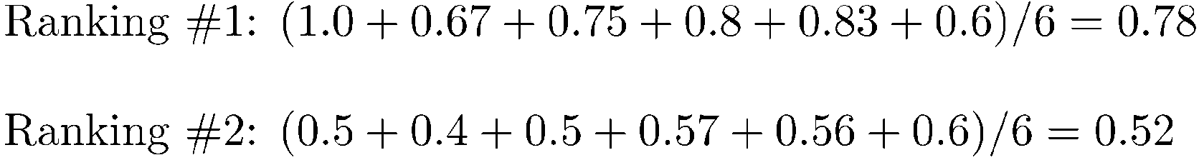
AvgPrec is about one query
AvgPrec of the two rankings
Figure from Manning Stanford CS276, Lecture 8

Slide 55
What does query averaging hide?
Figure from Doug Oard’s presentation, originally from Ellen Voorhees’ presentation

Slide 56
Measuring assessor consistency
kappa statistic
A measure of agreement between judges
$P(A)$ is the proportion of the times judges agreed
$P(E)$ is the proportion of times they would be expected to agree by chance
$κ=1$ if two judges always agree
$κ=0$ if two judges agree by chance
$κ<0$ if two judges always disagree
$$κ=\frac{P\left(A\right)−P(E)}{1−P(E)}$$

Slide 57
What we have not considered
The physical form of the output
User interface
The effort, intellectual or physical, demanded of the user
User effort when using the system
Bias IR research towards optimizing relevance-centric metrics

